Slide 1
GIT 101
An introduction to git source control system

Slide 2
Origins
Created by Finnish-American Software Engineer, Linus Torvalds (creator of Linux) in 2005 after BitKeeper revoked it’s free-of-charge status.
Linux was using BitKeeper for it’s kernal source control.
Torvalds and the Linux community decided to develop their own tool based on the lessons they learned while using BitKeeper
Time magazine, alone has recognized Torvalds multiple times:
In 2000, he was 17th in their Time 100: The Most Important People of the Century poll.
In 2004, he was named one of the most influential people in the world by Time magazine.
In 2006, the magazine's Europe edition named him one of the revolutionary heroes of the past 60 years.
Source: https://en.wikipedia.org/wiki/Linus_Torvalds

Slide 3
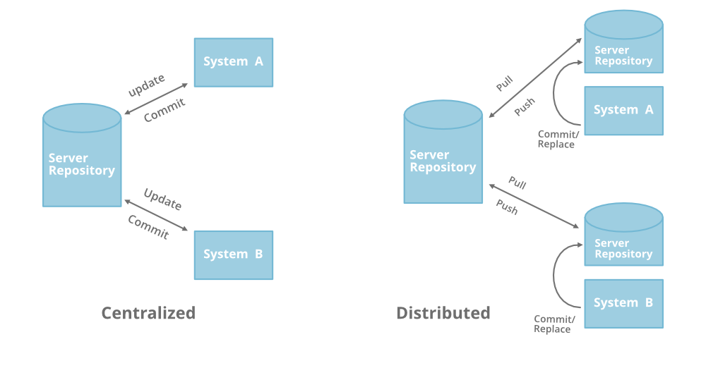
Centralized vs. distributed source control
TFS is a centralized source control system, while Git is distributed, which essentially means the entire repo is cloned to each developer’s machine.
With Git, each developer can ‘commit’ changes to their local machines without ever changing any code on the server.
With TFS, repos are stored on a central server and develops ‘check-out’ a working copy

Slide 4
CI/CD with Git
Continuous integration is a coding philosophy and set of practices that drive development teams to implement small changes and check in code to version control repositories frequently. Because most modern applications require developing code in different platforms and tools, the team needs a mechanism to integrate and validate its changes.
Continuous delivery picks up where continuous integration ends. CD automates the delivery of applications to selected infrastructure environments. Most teams work with multiple environments other than the production, such as development and testing environments, and CD ensures there is an automated way to push code changes to them.
Source:
https://www.infoworld.com/article/3271126/what-is-cicd-continuous-integration-and-continuous-delivery-explained.html

Slide 5
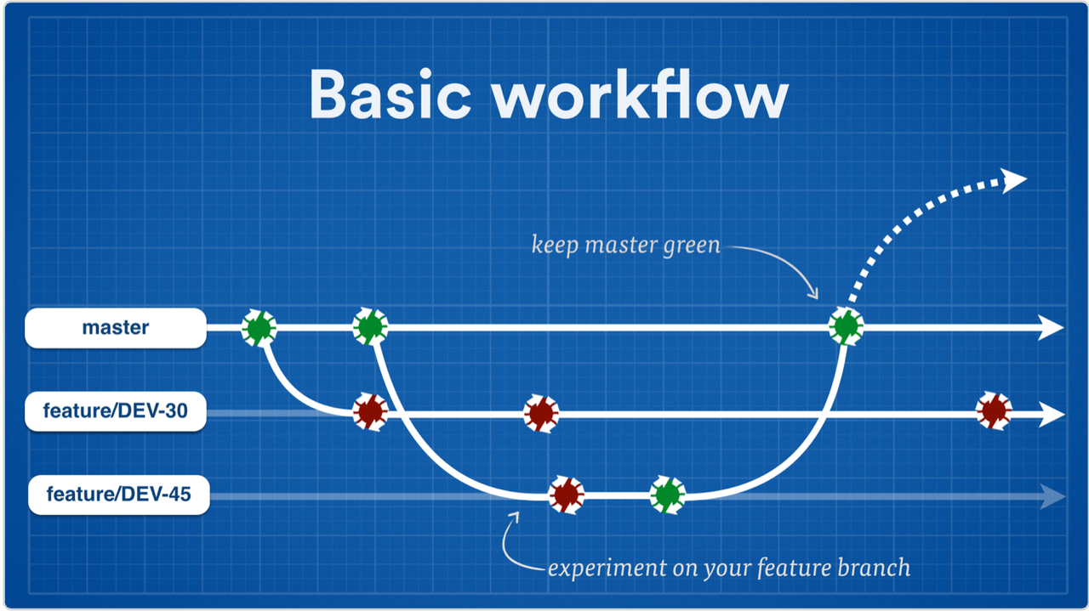
CI/CD with Git
Continuous Integration/Continuous Delivery

Slide 6
The basic commands
clone – create a copy of an entire repo – usually done once (per machine), in the beginning
fetch – updates metadata including commit history and branches (does not change code)
add (stage) – place a file in the staging area…ready to commit.
commit – takes a ‘snapshot’ of the changes you have staged. Only affects local repo (until push)
pull – gets changes from the server and updates your local repo
push – ‘push’ your commits to the server
branch – creates a line of development independent of the others (until merged)
checkout – choose a branch
merge – merge the code of different branches. (usually your feature and master)
Non-git terms
check-in – doesn’t exist in Git. Do you mean ‘commit’? or ‘push’? or both?
sync – Visual Studio’s term for a ‘pull’ and ‘push’ combined

Slide 7
Remember:
Make sure you’re on the intended branch. One of the best things about Git is the ability to switch back and forth between branches, checkout other developers branches and collaborate with their work, but if you make code changes on the wrong branch, it can be a pain.
You can only ever work on one branch at a time. Each branch is a potentially different version of all the content in the repo.
It’s almost always a good idea to ‘pull’ before ‘push’ (if anyone else could be making changes on the branch you’re working on) to avoid conflicts.
It’s also a good idea to ‘sync’ master often. You should make sure master is up-to-date and …

Slide 8
Let’s go!
Everybody go to https://github.com/ and sign up
Go to my repo for this training session https://github.com/BenJokela/GitTraining and clone to your machine

Slide 9
Devops specifics:
Create feature branch for your ticket through the DevOps web portal.
The branch should be made off of the parent ticket – PBI, bug or chore, not task.
If you need a db, restore a bu, make sure you have that branch checked out and 'link to source control'
When you commit changes in ssms, don't push from there, in case there are other commits. You can't see them in SSMS, use VS or another tool to push exactly what you want to push.
Once all commits are pushed, submit pull request through the DevOps web portal. Don't do it with VS, it doesn't always link to the ticket.
When you’re creating pull request, you must look through all the files and changes before submitting. Make sure you submitting exactly what you mean to.
When completing pull request, delete branch. Decide if you want to complete the associated work item (checkbox).

Slide 10
Valuable links
https://git-scm.com/

